Slide 1
Assembly – before and after
Lex Nederbragt
lex.nederbragt@ibv.uio.no
@lexnederbragt

Slide 2

A warning
The list is by no means complete
Nor do we have experience with all the programs mentioned

Slide 3
Sample
Reads
Genome assembly
DNA
DNA isolation
Sequencing
Assembly
QC
QC
QC

Slide 4
Reads
Genome assembly
Assembly
QC

Slide 5
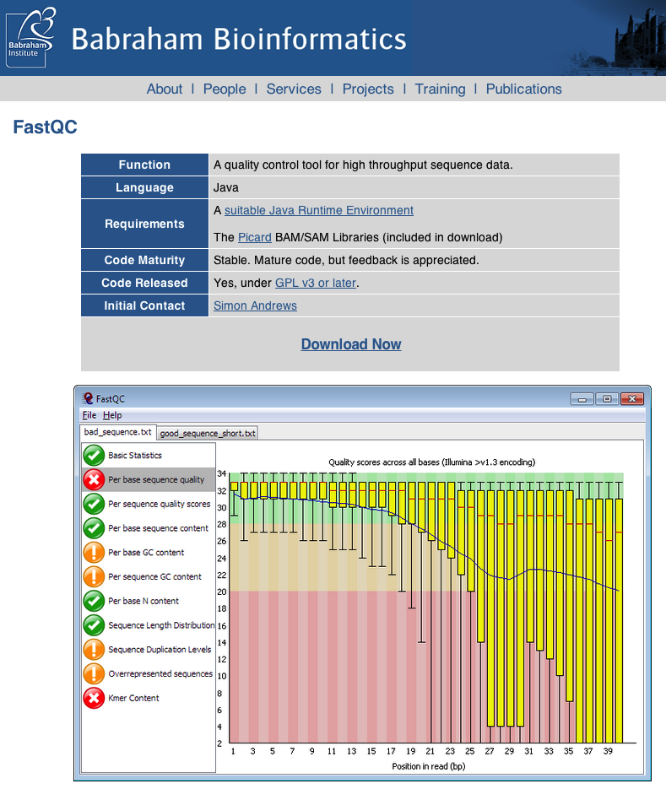
Fastqc

Slide 6
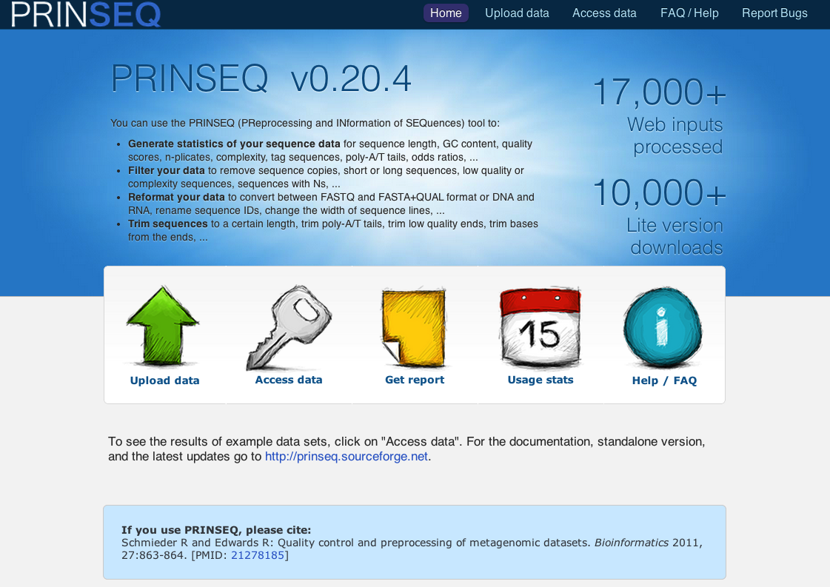
Prinseq

Slide 7

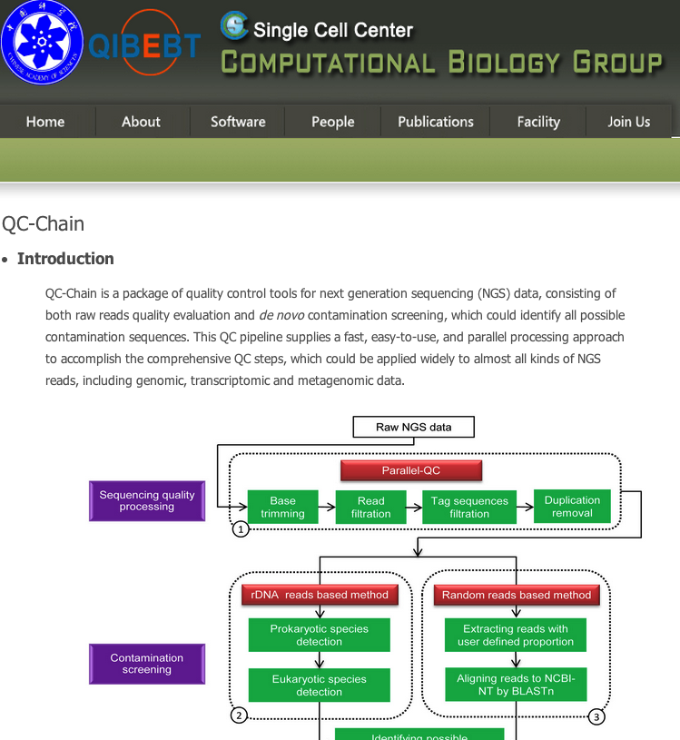

Many others…
www.nipgr.res.in/ngsqctoolkit.html

Slide 8
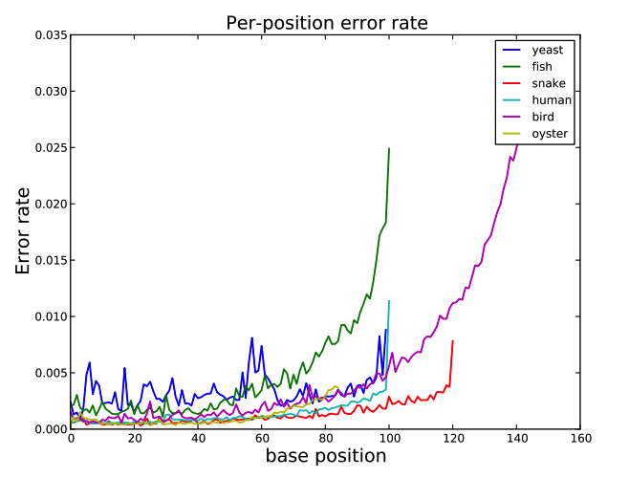
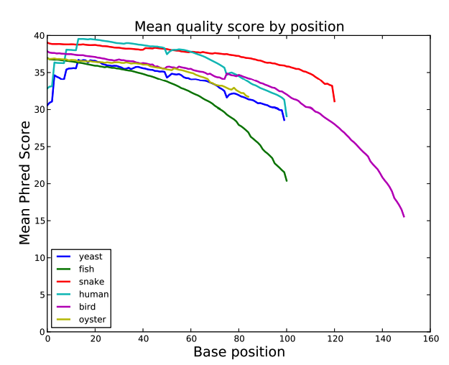
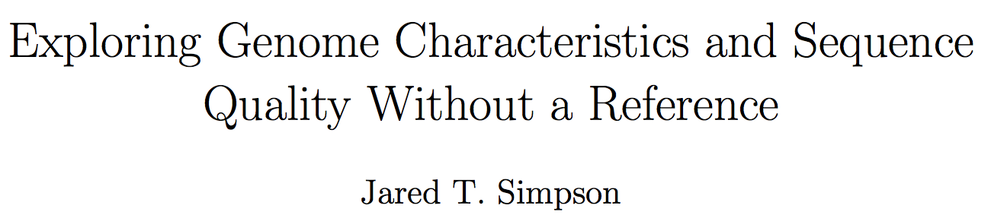
preqc (sga)
http://arxiv.org/abs/1307.8026

Slide 9
Reads
Genome assembly
Assembly
Grooming

Slide 10
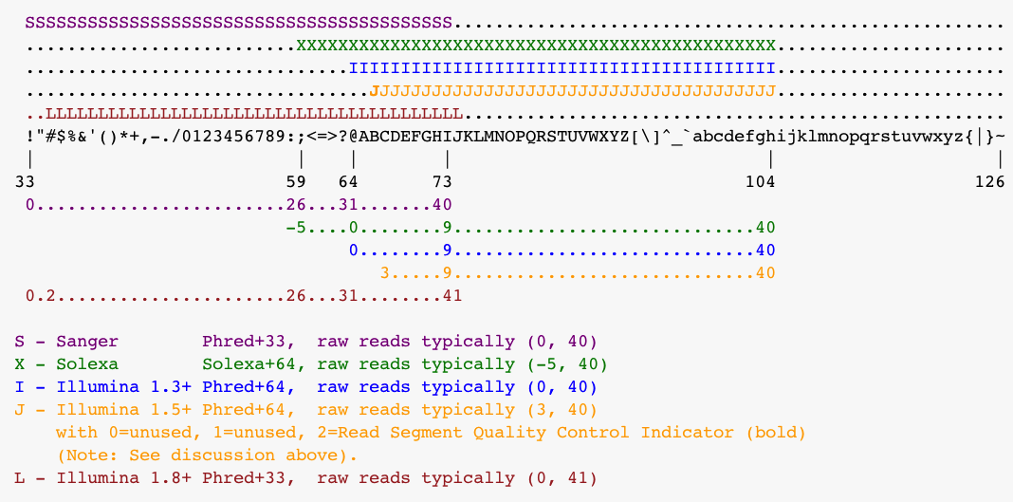
Format conversion
Fastq format hell
http://en.wikipedia.org/wiki/FASTQ_format

Slide 11
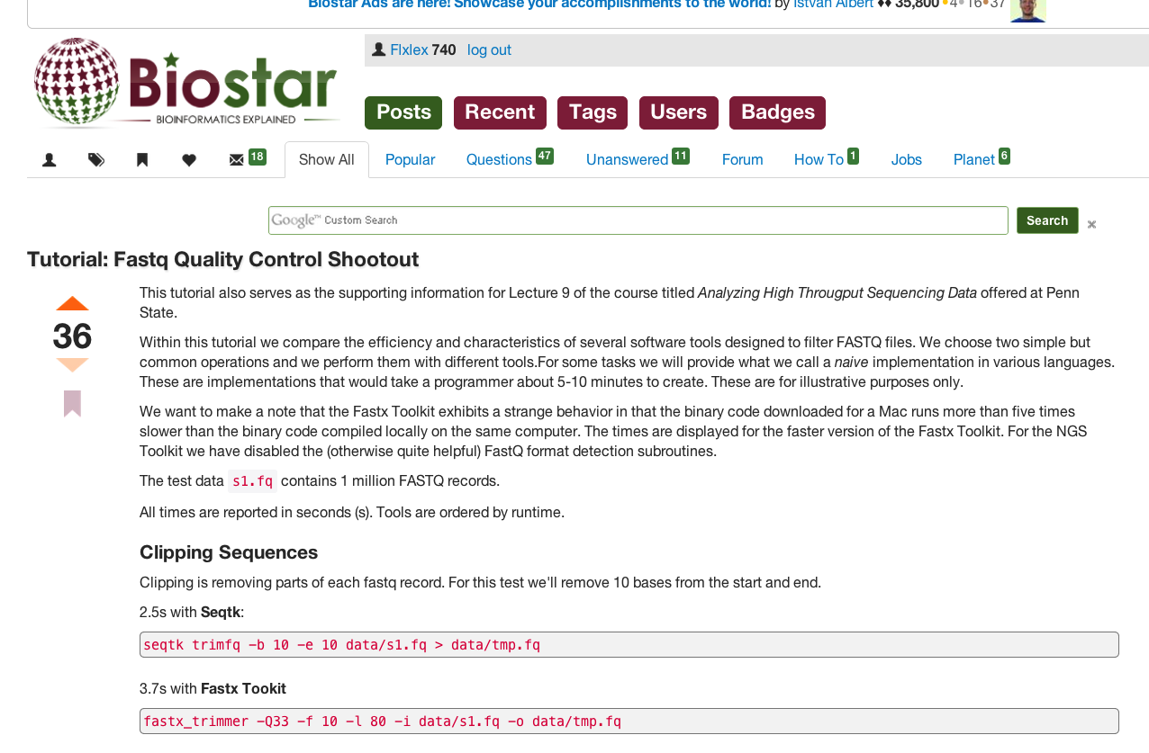
Adapter/quality trimming
Celera assembler
Overlap based trimming
Fastx Toolkit
Seqtk
PrinSeq
NGS QC Toolkit
Trimmomatic
BioPieces
Cutadapt
…
…
http://www.biostars.org/p/53528/

Slide 12
Mate pair splitting and orientation
Illumina paired end reads
150 – 600 bases
Illumina mate pair reads
2 – 40 kilobases
454 mate pair reads
linker
2 – 40 kilobases

Slide 13
Mate pair splitting and orientation
Illumina paired end reads
Illumina mate pair reads
+
+
junction
junction
paired end reads ‘contamination’
454 mate pair reads
linker

Slide 14
Mate pair splitting and orientation
Illumina paired end reads
Check what orientation your assembler expects for the reads!
Illumina mate pair reads
+
+
junction
junction
paired end reads ‘contamination’
454 mate pair reads
linker

Slide 15
Preparing
Reads
Genome assembly
Assembly

Slide 16
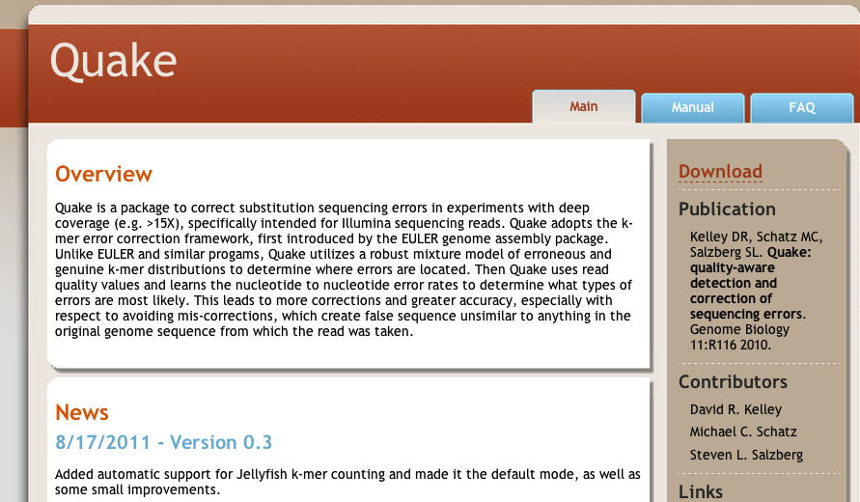
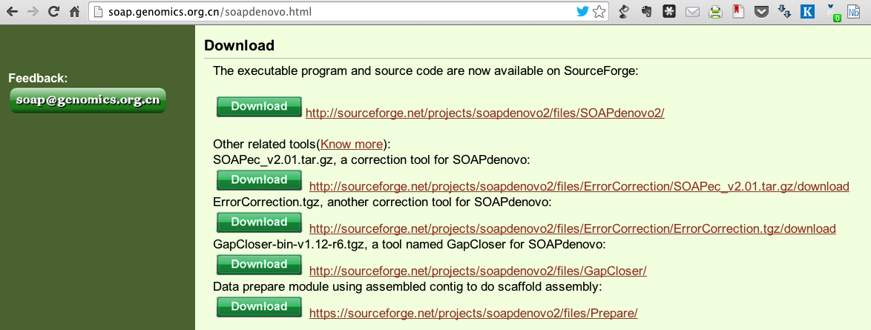
Error-correction
Stand-alone or built into assembler

Slide 17
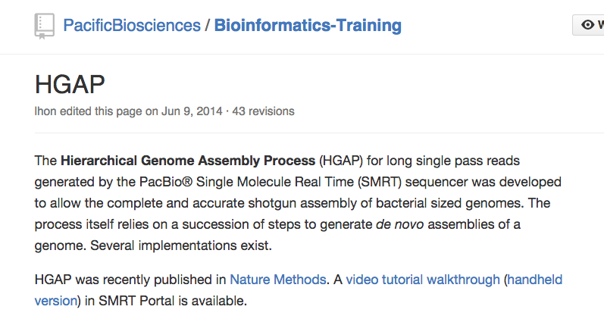
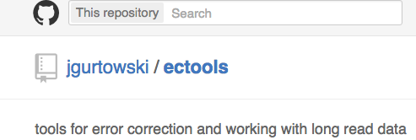
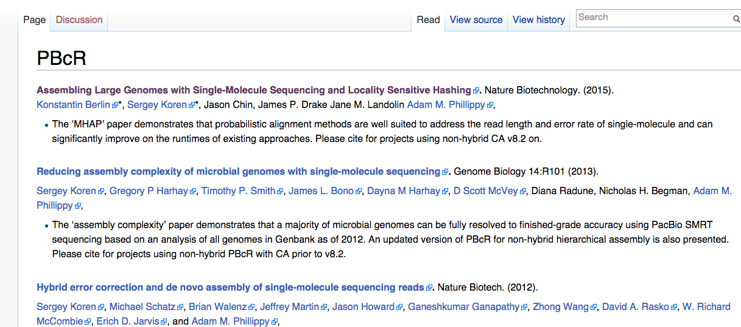
Error-correction
Of long noisy reads
https://github.com/jgurtowski/ectools
github.com/PacificBiosciences/Bioinformatics-Training/wiki/HGAP
http://wgs-assembler.sourceforge.net/wiki/index.php/PBcR

Slide 18
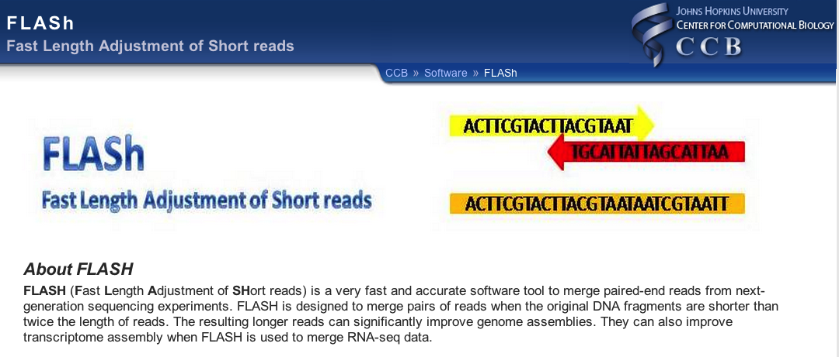
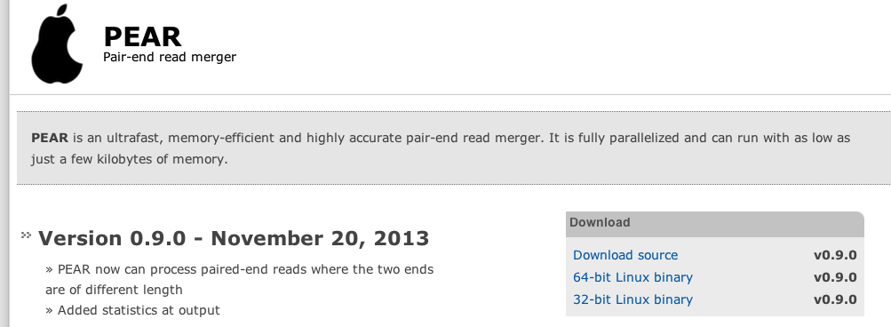
Merging pairs
COPE http://sourceforge.net/projects/coperead/
SeqPrep https://github.com/jstjohn/SeqPrep
FLASH http://www.cbcb.umd.edu/software/flash
fastq-join http://code.google.com/p/ea-utils/wiki/FastqJoin
PANDAseq https://github.com/neufeld/pandaseq
mergePairs.py http://code.google.com/p/standardized-velvet-assembly-report/source/browse/trunk/mergePairs.py
List from Torsten Seeman’s blog
http://thegenomefactory.blogspot.no/2012/11/tools-to-merge-overlapping-paired-end.html
Recent addition

Slide 19

Extend reads
http://140.116.235.124/~tliu/arf-pe/

Slide 20
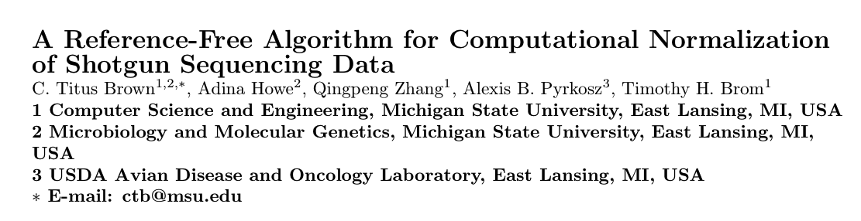

Digital normalisation
http://arxiv.org/abs/1203.4802

Slide 21
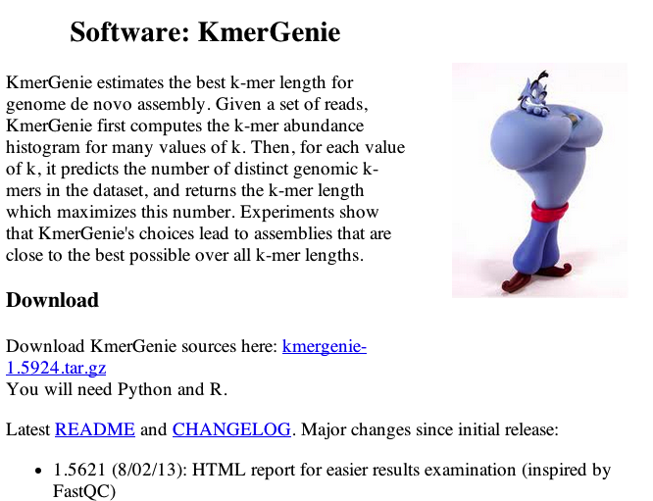
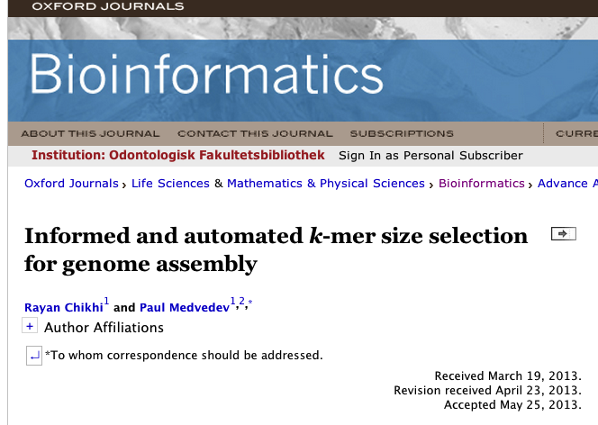
Estimate kmer to use
preqc (SGA)
http://arxiv.org/abs/1307.8026

Slide 22
Reads
Genome assembly
Assembly
What can the reads tell us about the genome

Slide 23
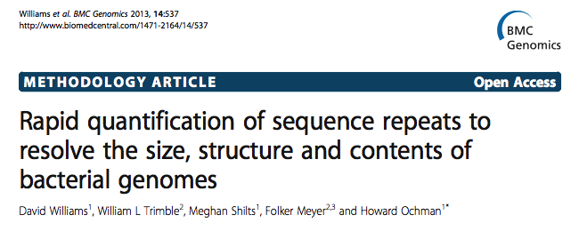
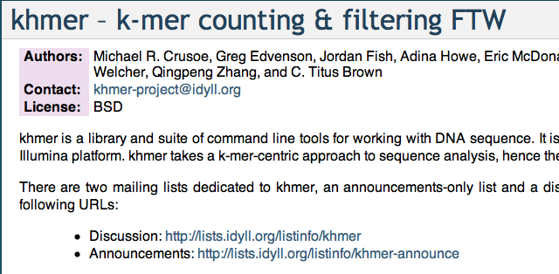
kmer-based
Kmerspectrumanalyzer
preqc (SGA)
Khmer from Titus
http://arxiv.org/abs/1307.8026

Slide 24
Reads
Genome assembly
Assembly
This
talk

Slide 25
Reads
Genome assembly
Assembly
QC

Slide 26
Merging
Improvement
Validation
Genome assembly
Metrics
Visualization
Comparing to reference
Comparing to each other

Slide 27
Merging
Improvement
Validation
Genome assembly
Metrics
Visualization
Comparing to reference
Comparing to each other

Slide 28
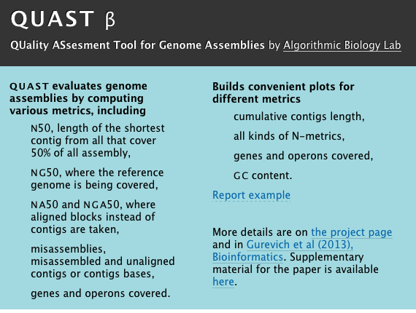
Assemblathon stats
http://korflab.ucdavis.edu/datasets/Assemblathon/Assemblathon2/Basic_metrics/assemblathon_stats.pl
OR
https://github.com/lexnederbragt/sequencetools/

Slide 29
Merging
Improvement
Validation
Genome assembly
Metrics
Visualization
Comparing to reference
Comparing to each other

Slide 30


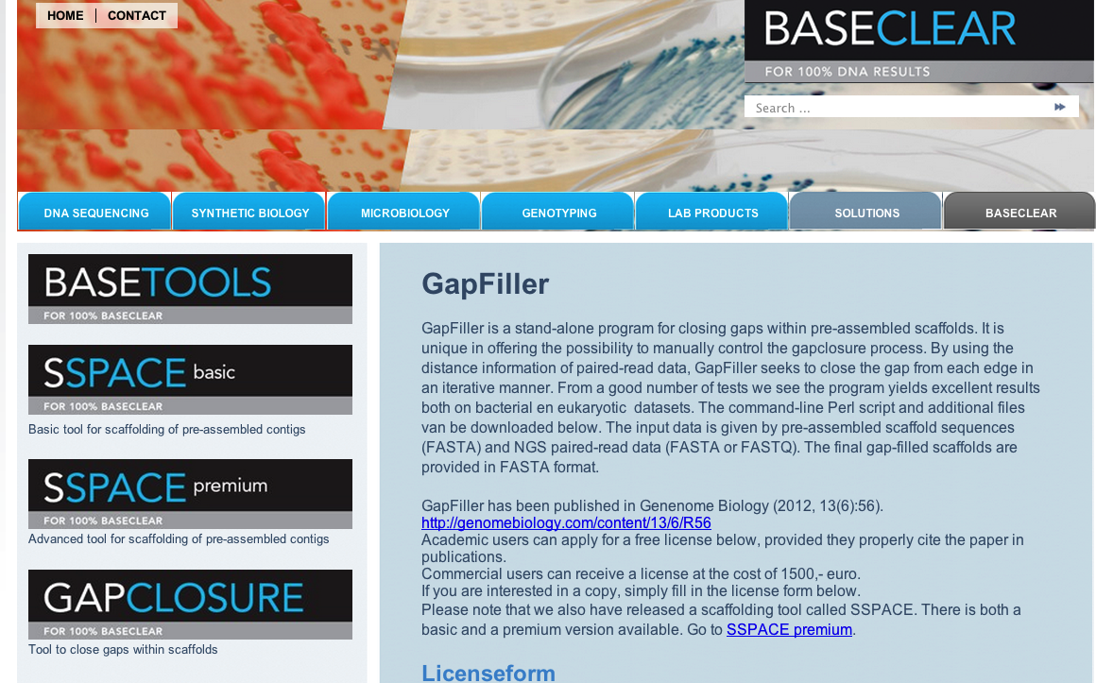
Gap closing
IMAGE2

Slide 31
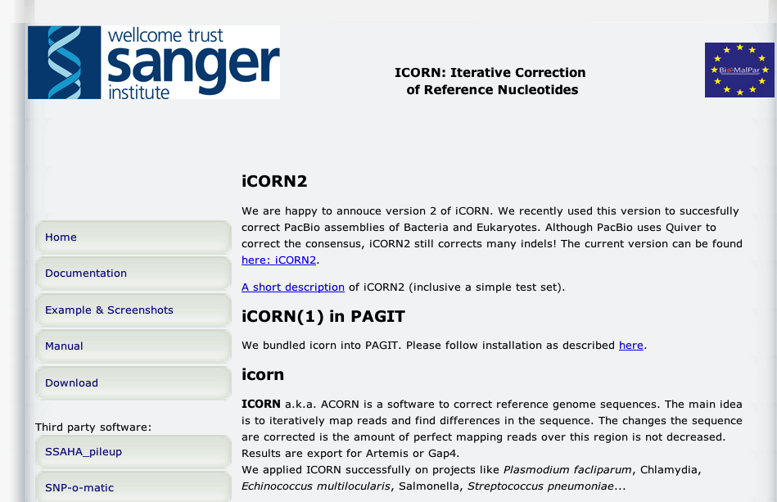
Correcting bases
Quiver from Pacific Biosciences

Slide 32
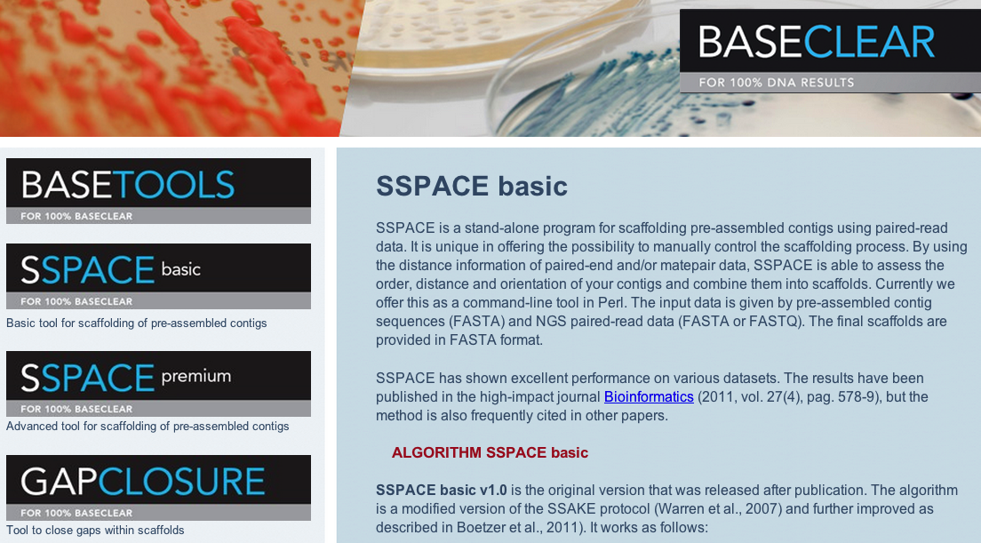
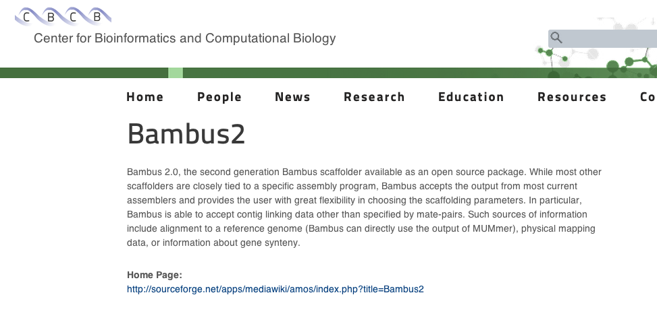
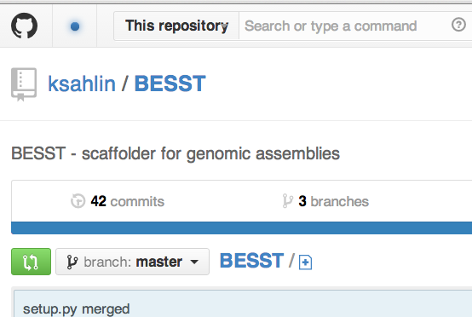
Separate scaffolding

Slide 33
Merging
Improvement
Validation
Genome assembly
Metrics
Visualization
Comparing to reference
Comparing to each other

Slide 34
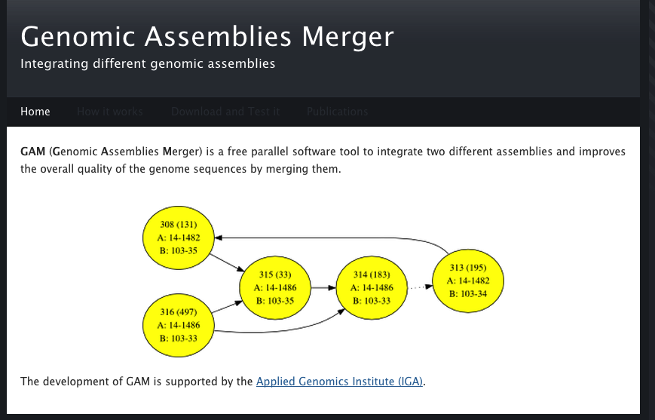
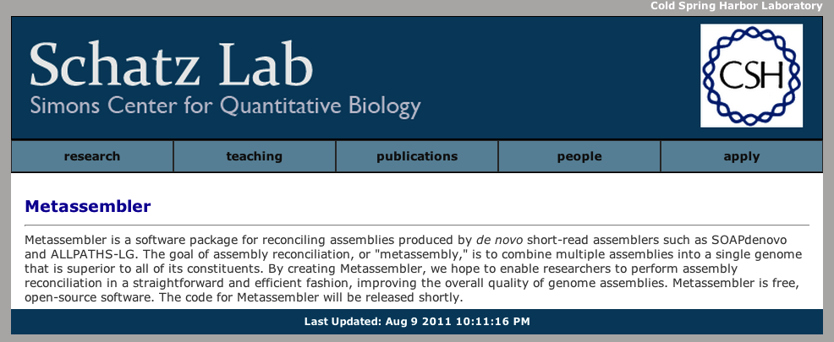
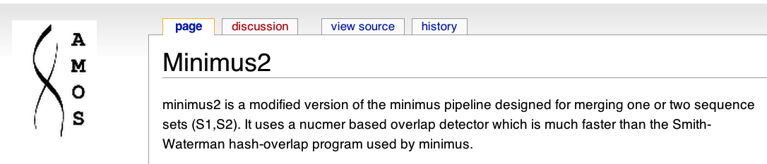
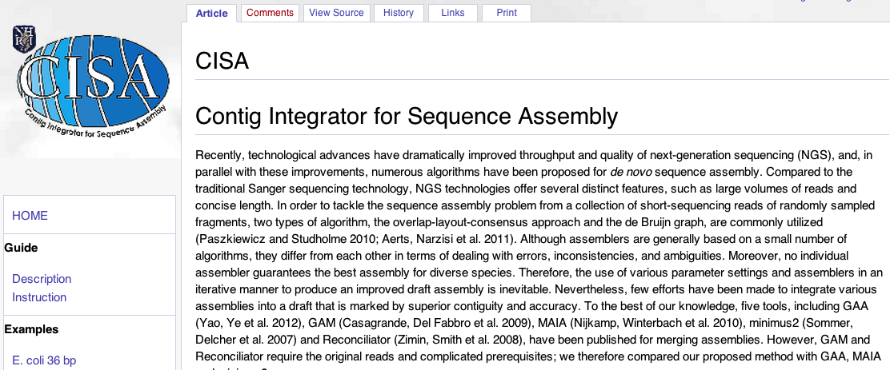
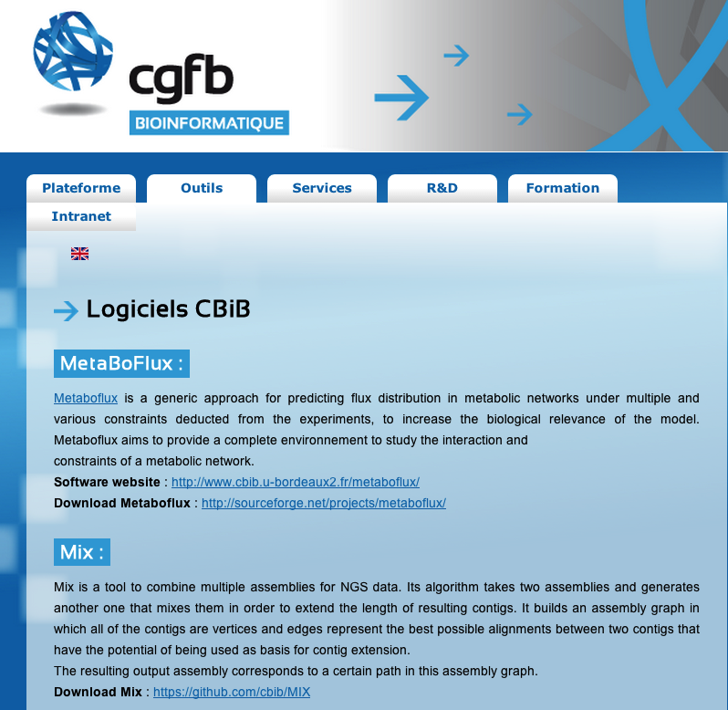

Assembly merging/reconciliation

Slide 35
Merging
Improvement
Validation
Genome assembly
Metrics
Visualization
Comparing to reference
Comparing to each other

Slide 36
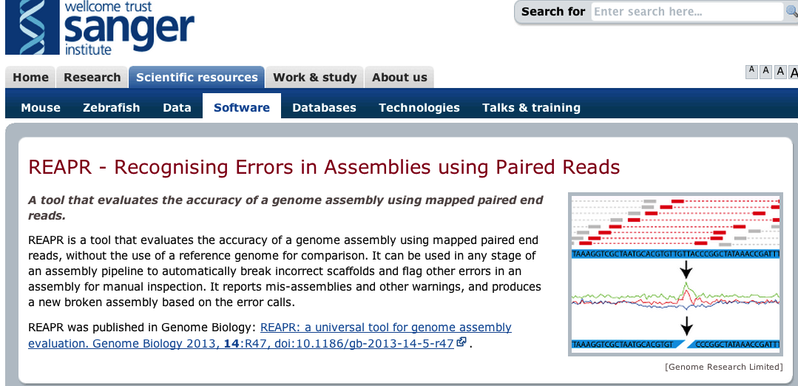

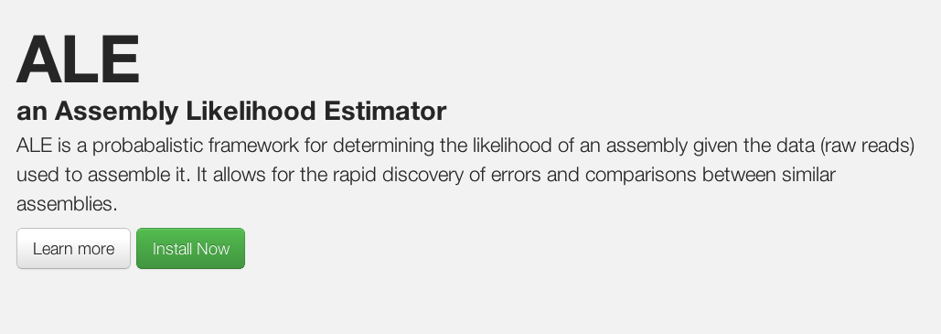
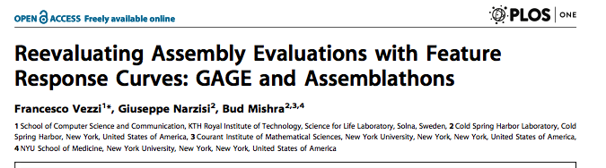
Mapped genomic reads
FRCBAM

Slide 37
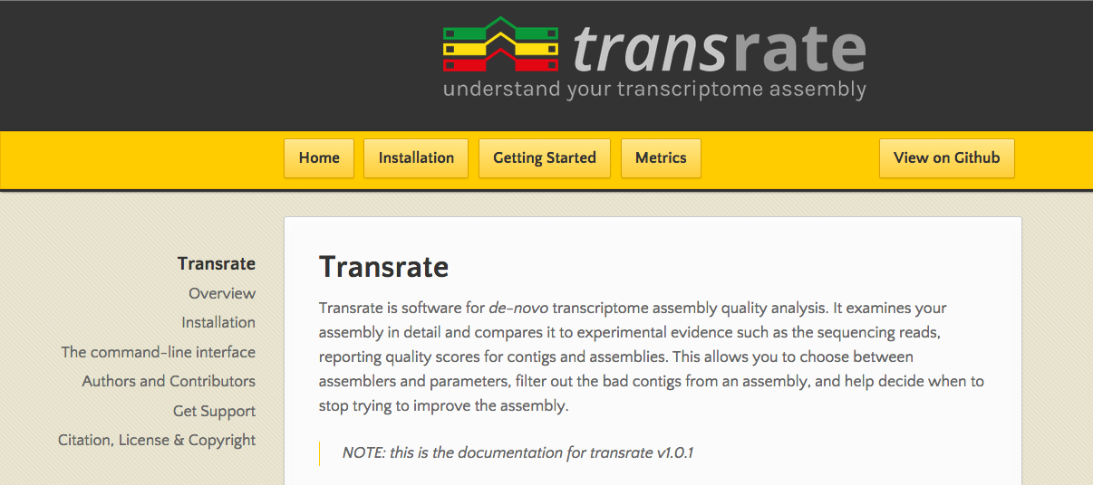
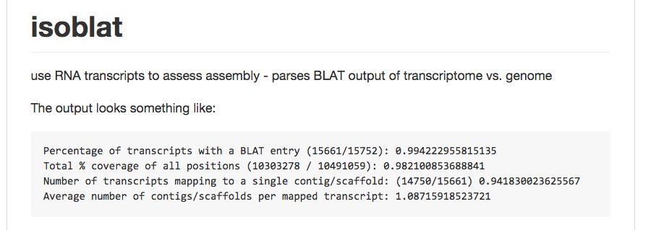
Mapped transcriptomic reads
http://hibberdlab.com/transrate/
https://github.com/josephryan/isoblat

Slide 38
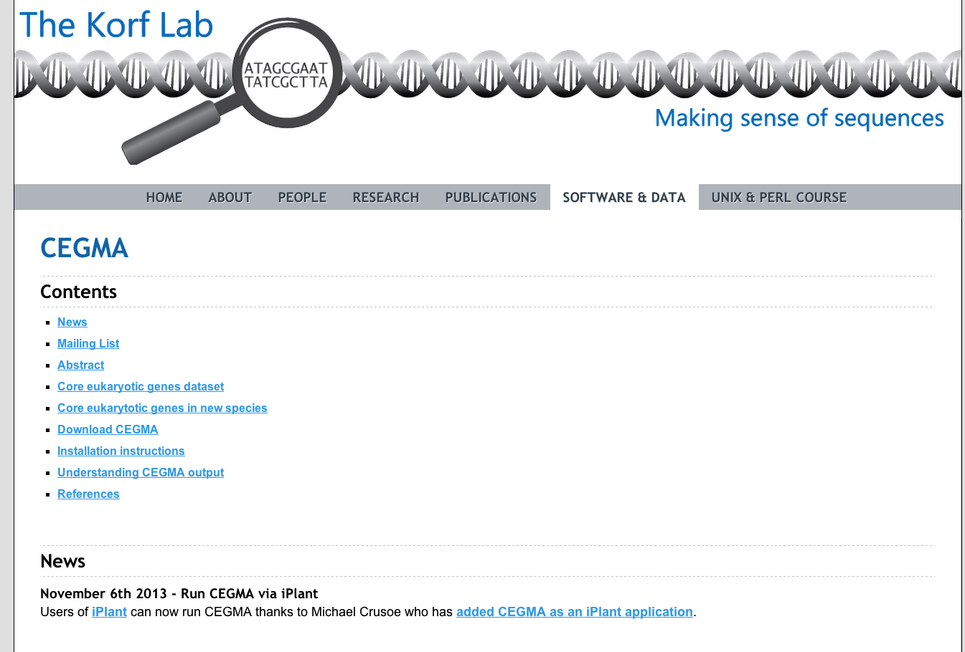

Gene finding

Slide 39
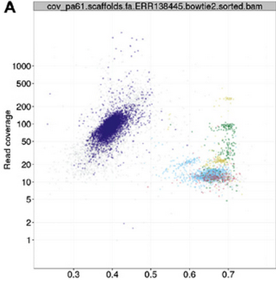
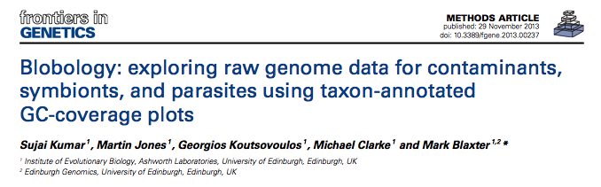
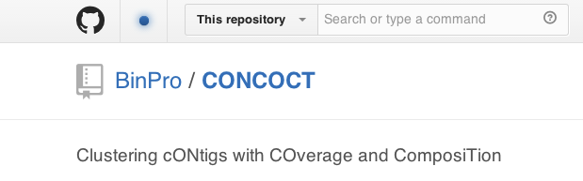
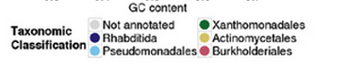
Binning
Nederbragt et al, 2010

Slide 40
Merging
Improvement
Validation
Genome assembly
Metrics
Visualization
Comparing to reference
Comparing to each other

Slide 41
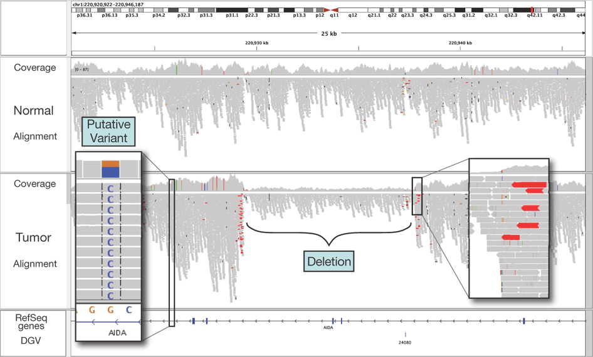
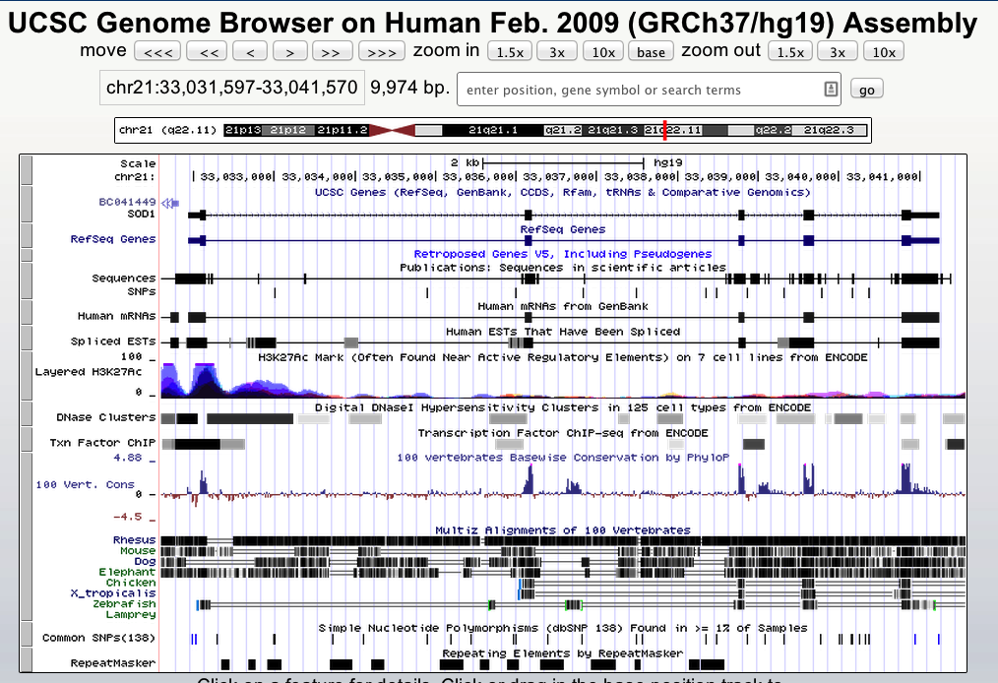
Genome browser(s)
IGV

Slide 42
Merging
Improvement
Validation
Genome assembly
Metrics
Visualization
Comparing to reference
Comparing to each other

Slide 43
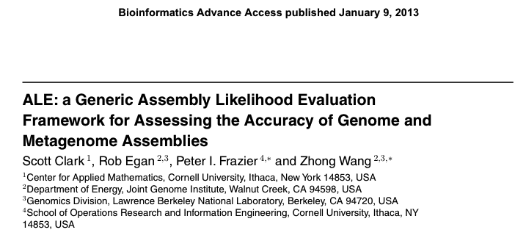


Comparative measures
Assembly Likelihood Evaluation (ALE)
Log Average Probability (LAP)
See also Howison, Zapata2 and Dunn (2013) Toward a statistically explicit understanding of de novo sequence assembly doi: 10.1093/bioinformatics/btt525

Slide 44
Merging
Improvement
Validation
Genome assembly
Metrics
Visualization
Comparing to reference
Comparing to each other

Slide 45
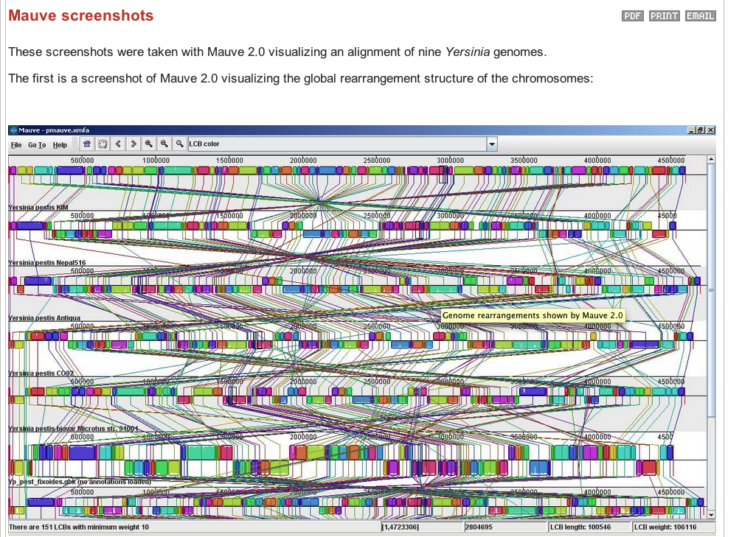
Reference comparison
Mauve assembly metrics

Slide 46
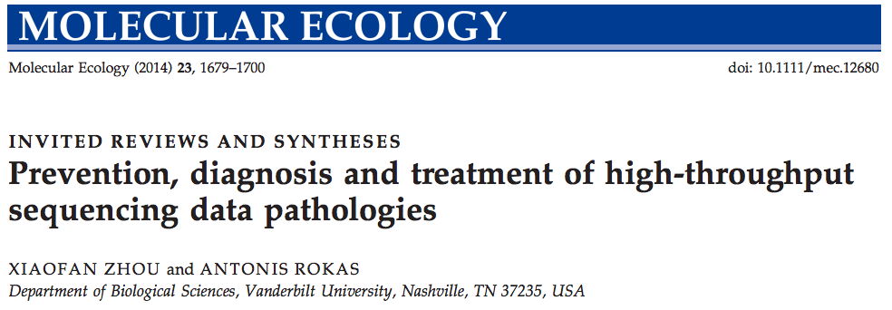
Review

Slide 47
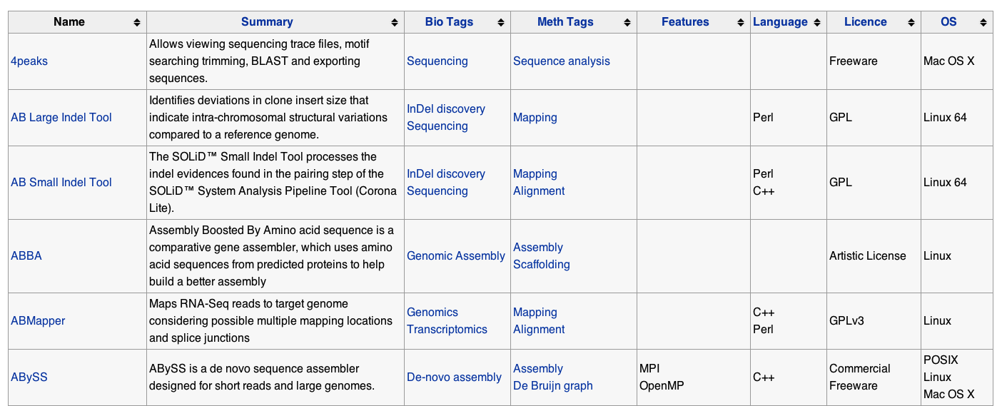
Too many tools…
http://seqanswers.com/wiki/Software/list

Slide 48
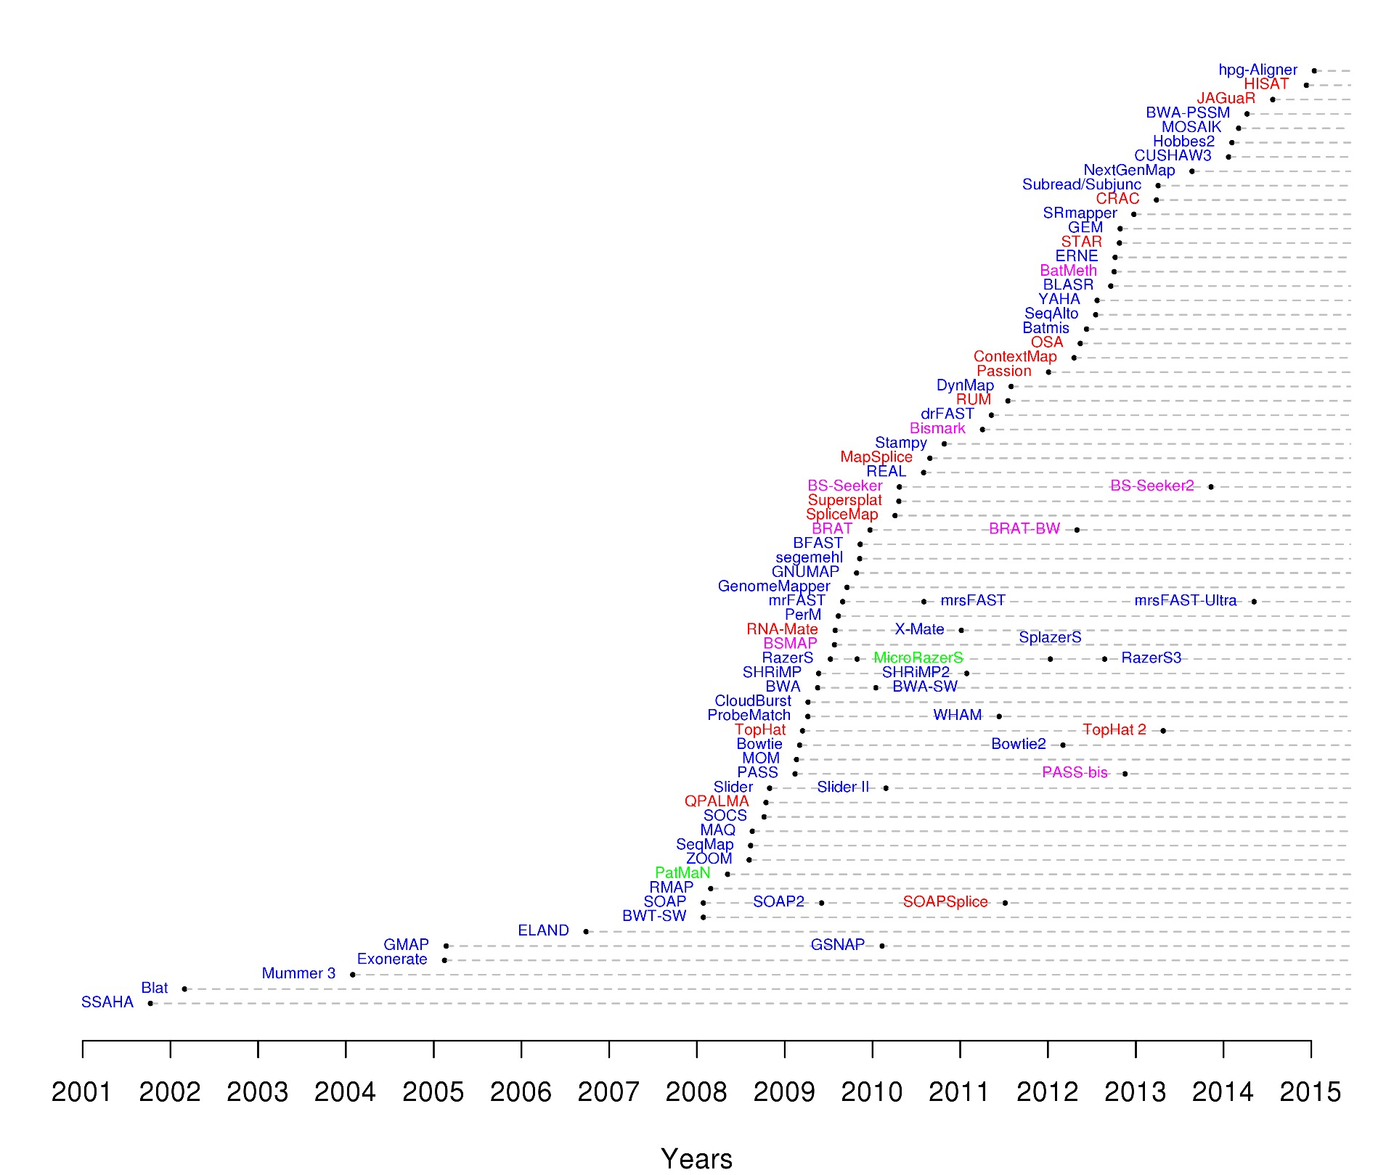
Too many tools…
88 short-read mappers
http://www.ebi.ac.uk/~nf/hts_mappers/

Slide 49
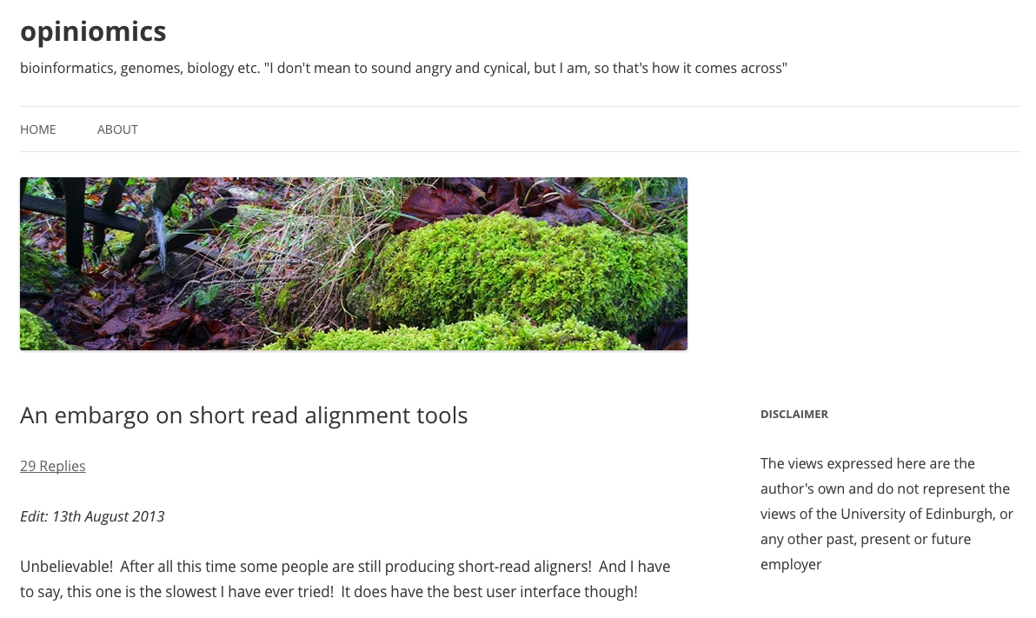
Embargo!

Slide 50

Benchmarking, anyone?

Slide 51
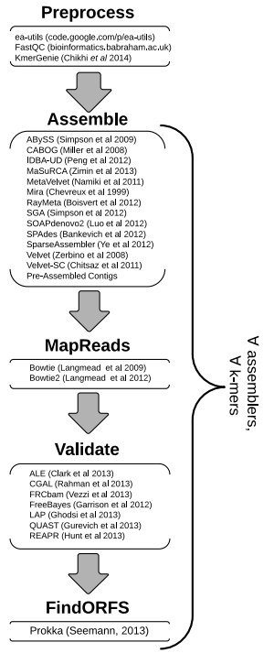

All-in-one assembly pipeline
doi:10.1186/1471-2105-15-126

